Slide 1
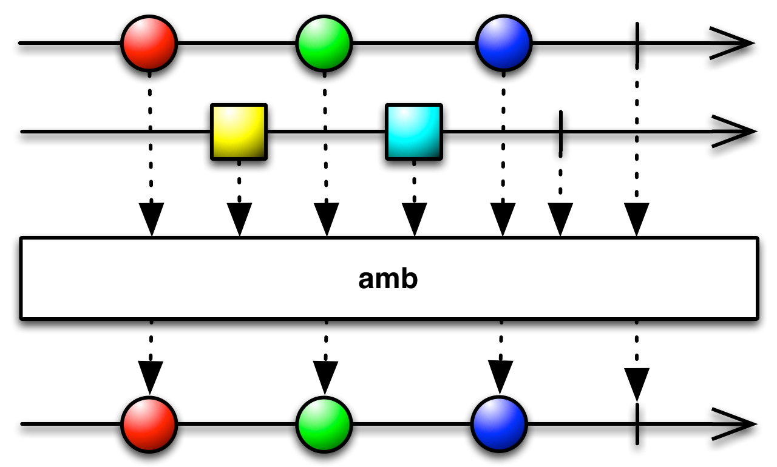
Reactive Programming
Introduction to Pivotal Reactor
by Victor Grazi
twitter: @vgrazi
vgrazi@gmail.com
https://github.com/vgrazi/reactive-demo

Slide 2
Agenda
What is Reactive?
Flux basics
Marble diagrams
Cold Fluxes
Hot Fluxes
Demos
Basic operations
Controlling emission rate
Attaching to a feed

Slide 3
What is Reactive?
Alternate programming paradigm – think in terms of streams instead of objects.
Reactive Streams –high-performance, asynch stream processing non-blocking back pressure.
Declarative tools for concise, error free code, especially under high load and concurrency.
Simplify clean coding of asynchronous event driven programming.
The good news is, it does not change much from language to language.

Slide 4
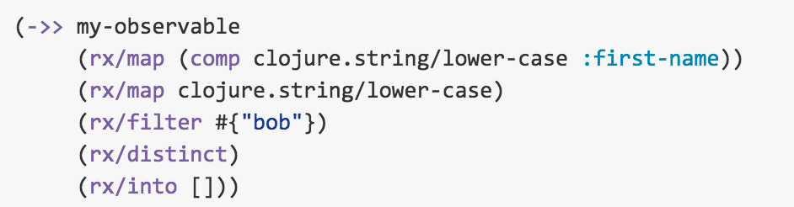
Cross language support
Java
CloJure
my_observable .map(Name::firstName) .map(String::toLowerCase) .filter(x -> x.startsWith("bob")) .distinct() .toList()

Slide 5
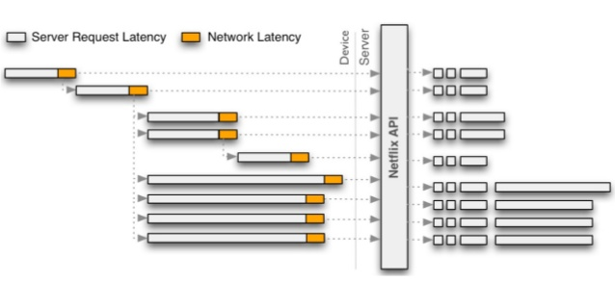

Problem: Merging many requests
Server Request Latency
Network Latency
Device
Server
Netflix API

Slide 6
Maven Dependencies
<dependency>
<groupId>io.projectreactor</groupId>
<artifactId>reactor-core</artifactId>
</dependency> <dependency>
<groupId>io.projectreactor.addons</groupId>
<artifactId>reactor-test</artifactId>
</dependency>

Slide 7
Basic Model
Everything is a stream of messages
Flux emits event messages (“Observable” in rx-java land)
Subscribers consume messages
Fluxes are immutable (operations return new Fluxes)
Flux
Subscriber
Implements Publisher
Emits messages from:
Remote services
Data feeds
Mouse events…
Message stream
Examples:
Events
Query results
Computations
Even errors!
Subscriber
Consumes pushed messages:
onNext()
onError()
onComplete()

Slide 8
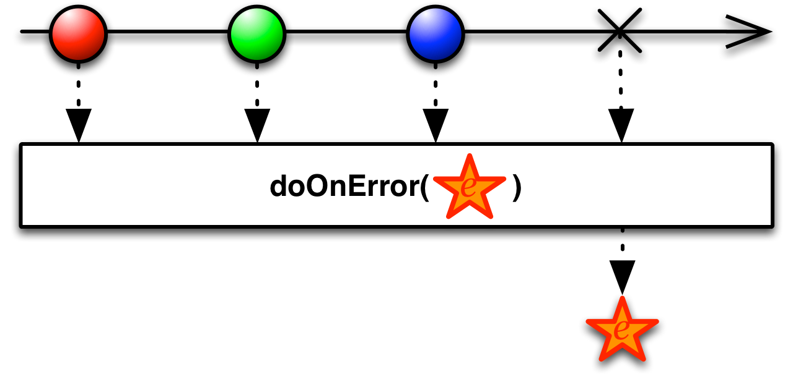
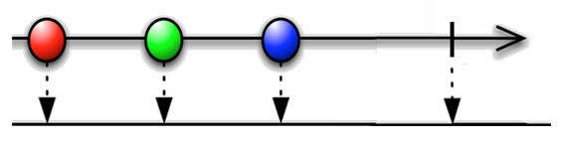
A Subscriber receives notifications:
public interface Subscriber<T>
void onNext(T t); void onComplete(); void onError(Throwable t); void onSubscribe();
onNext()
onComplete()
onError()
(onError() and onComplete() are terminal operations.)

Slide 9
…Attaching a Subscriber
flux.subscribe(
v -> handleHappyPath(v), // happy path
error -> handleError(error), // error handler // (optional)
() -> handle(“Done") // completion
// (optional)
);

Slide 10
Transform and combine Flux streams
Or
Flux
.map(…)
.subscribe(…)
Or even
Flux
Flux
.filter(…)
.subscribe(…)
.filter(…)
.map(…)
.doOnNext(System.out::println)
.subscribe(…)
.filter(…)
.map(…)
.subscribe(…)
etc., etc., etc.
Each transformation returns a new resultant Flux.
Notes:
Talk about assigning each step to a new Flux variable if you have trouble getting things to compile. It makes it easier to see what has gone wrong and what is required to correct it

Slide 11
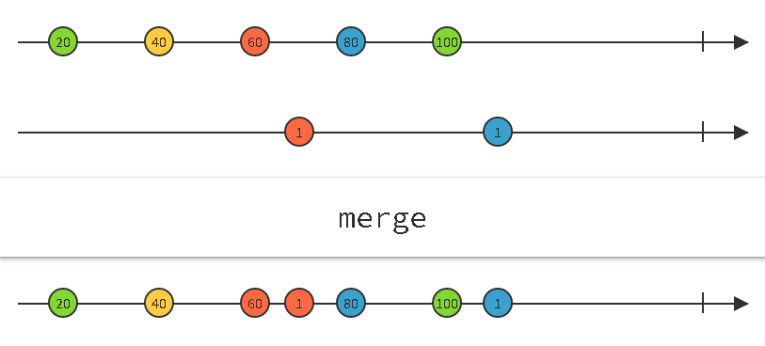
MARBLE DIAGRAMS
http://rxmarbles.com/ Interactive marble diagrams

Slide 12
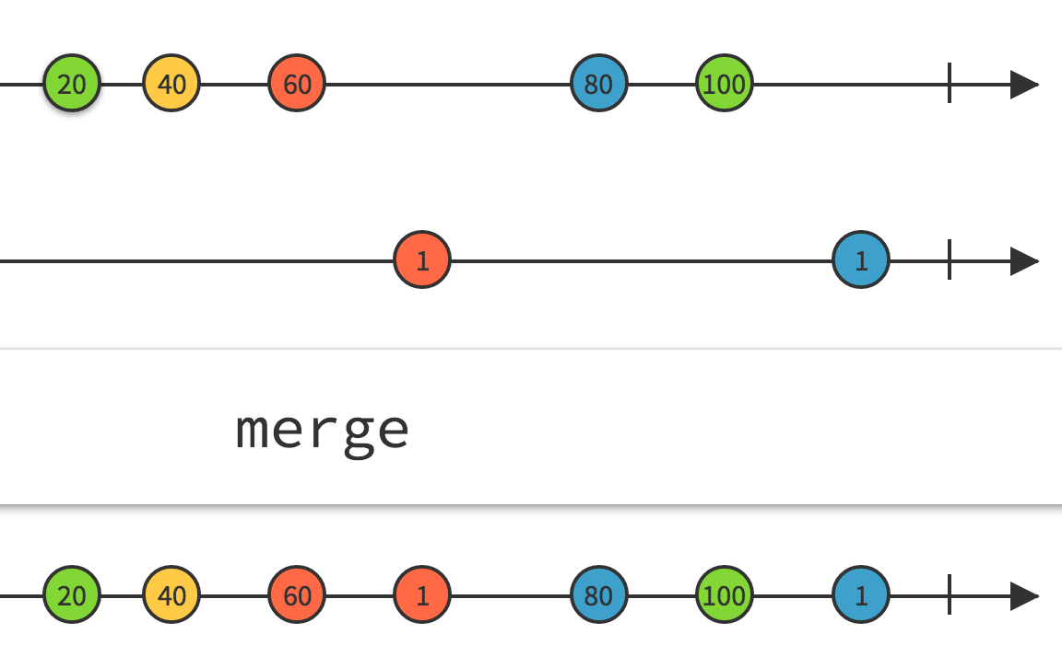
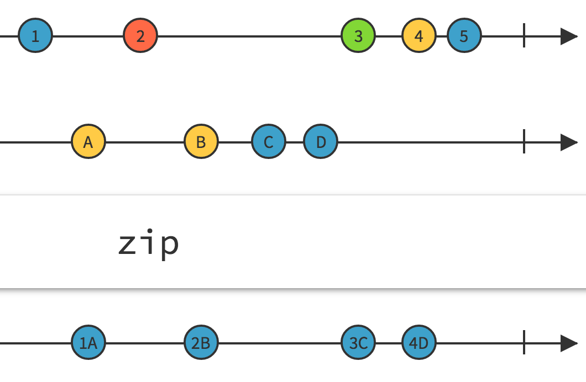
Combine Fluxes to produce new Fluxes
Methods take one Flux as input and return another Flux.
Examples: merge – merges elements as they arrive.
zip – combines elements in sequence.
firstEmitting – returns the first stream to emit an element.

Slide 13
Creating a Flux
Flux.just(value) – Creates instance that emits the supplied value(s).
Flux.fromIterable/fromArray(values) – Accepts Collection<T> or array, creates a Flux<T>, which emits the values of the collection.
Flux.range(i, n) – Produces n consecutive integers starting from i.
Flux.interval(Duration.ofSeconds(n)) – Emits a count, every n time units
etc. etc. etc.

Slide 14
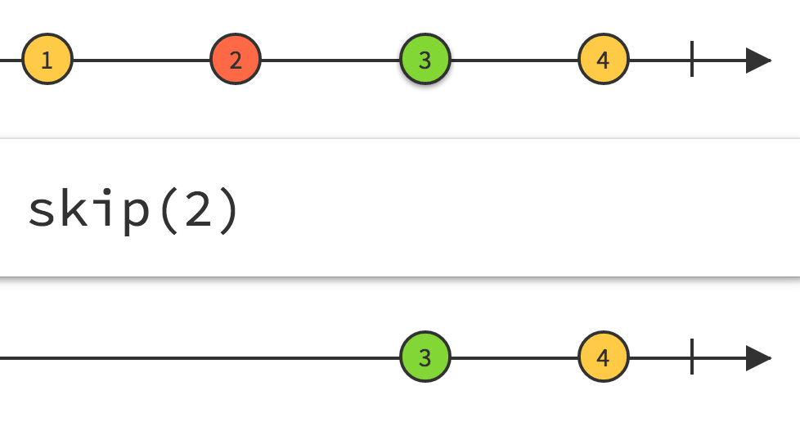
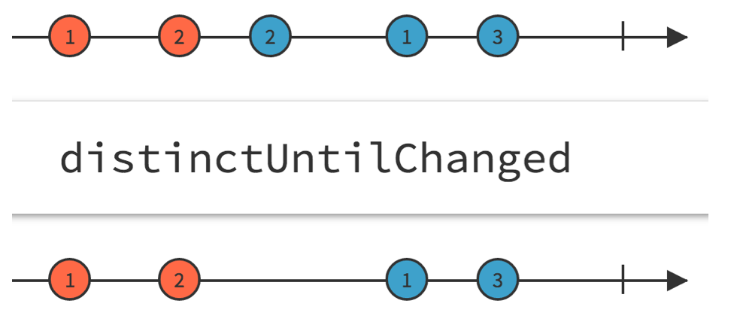
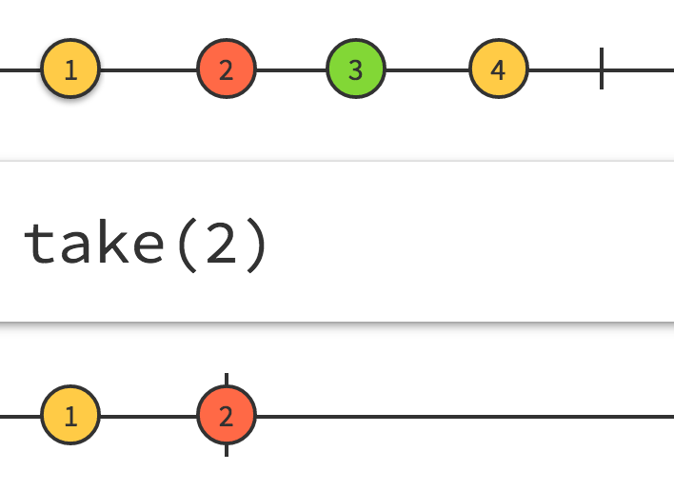
Transforming Fluxes
Methods take one stream as input and return another stream.
Flux.take(n) – Takes first n elements only.
Flux.skip(n) – Skips first n elements, then takes the rest
Flux.distinct() – Returns a new Flux with duplicates eliminated.
Flux.distinctUntilChanged() – Eliminates consecutive duplicates.
Flux.filter((x)->condition()) – Retains elements matching filter condition.
Flux.map(Some::mapper) – Replaces elements with other elements.
Flux.flatMap(Some::mapper) – Replaces elements with Fluxes.

Slide 15
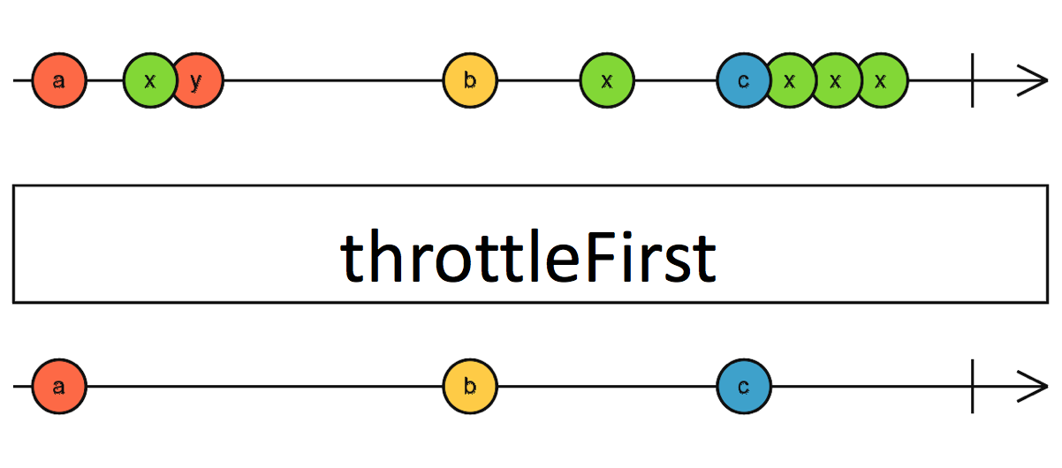
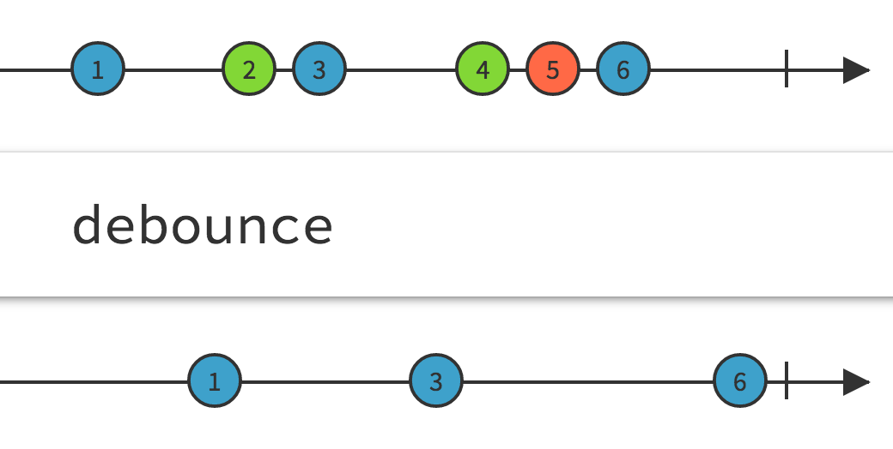
Time Filtering
Select elements based on timing
throttleFirst() – Takes only the first after every n time units
throttleLast() – Takes only the last element after every n time units
debounce() – Takes only the last event of each set in the specified time.
timeout() – Issues an exception if no events before timeout
debounce

Slide 16
Difference between Java Stream API and Reactive
Java Streams | Reactive Streams
Pull based | Push based
Basically a way to iterate collections declaratively | Attach to real-time feeds
Generally synchronous data | Real-time, concurrency, flow control
Streams can only be used once | Reactive streams are highly reusable
No control of timing | Control back-pressure strategies
No composition of streams | Advanced composition and transformation
Finite amount of data | Data sizes from zero to infinity

Slide 17
Concurrency footnote
Observers are synchronous; concurrent calls are handled in sequence
No need to code defensively for concurrency
And no loss in latency due to synchronization

Slide 18
Asynchronous Streams
Built in support for concurrent publishers and subscribers
Flux.observeOn(scheduler) – Specifies the thread for the Observer
Flux.subscribeOn(scheduler) – Specifies the thread for the Subscriber
Types of schedulers
Schedulers.immediate() – Parks current process and uses current thread
Schedulers.computation() – The system-assigned computation thread
Schedulers.io() – The system-assigned IO thread
Schedulers.trampoline() – Uses the current thread, once it is done here
Schedulers.newThread() – Uses a new thread
Schedulers.from(Executor) – On the named executor

Slide 19
Cold Fluxes and Hot Fluxes
Cold Fluxes
Won’t begin pumping until a subscriber is attached.
Each subscriber receives all of the events, beginning from the historical first.
Hot Fluxes
Generally read live data, for example data feeds or mouse movements.
Begin pumping on connection.
Each subscriber gets the latest feeds as they pump

Slide 20
Additional Cold Fluxes (for Development)
Flux.empty() – Completes on the first subscription, without emitting any values.
Flux.never() – Emits no values and never completes.
Flux.error() – Emits an onError() notification immediately on every subscriber. No other values are emitted.
Flux.doOnNext() – Diagnostics

Slide 21
Creating Hot Fluxes (Flowables)
Call “publish” on a cold Flux
ConnectableFlux<Long> hotFlux = coldFlux.publish();
Call “connect” to start pumping, with or without subscribers
hotFlux.connect();
hotFlux.subscribe( val -> System.out.println("Subscriber >> " +val));
Notes:
http://blog.xebia.in/2015/09/01/day1-building-an-application-from-scratch-using-rxjava-and-java8/

Slide 22
Introducing Reactive Programming Pivotal’s Reactor
Demo
by Victor Grazi
twitter: @vgrazi
vgrazi@gmail.com
https://github.com/vgrazi/reactive-demo

Slide 23
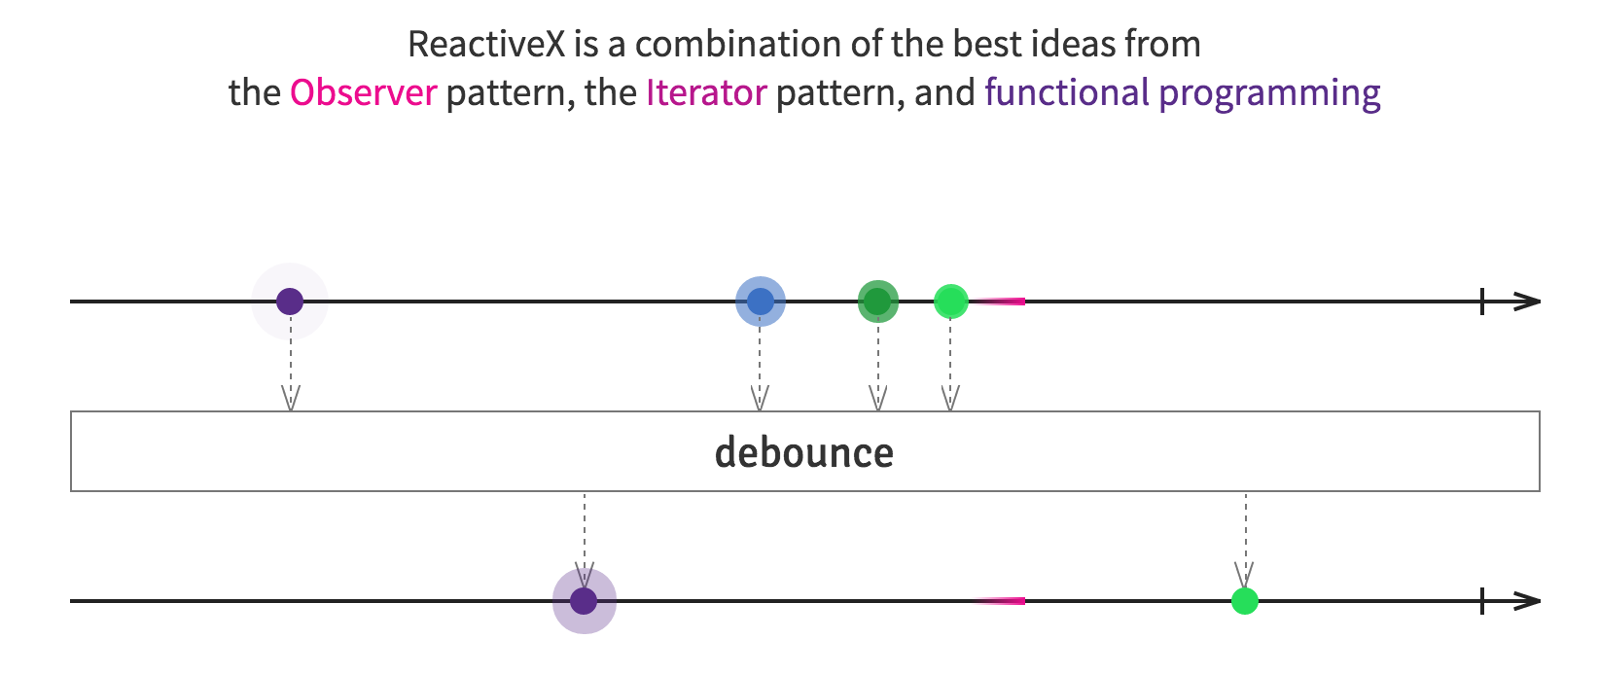
Introducing Reactive Programming Pivotal’s Reactor
?
?
?
?
Q&A
by Victor Grazi
twitter: @vgrazi
vgrazi@gmail.com
https://github.com/vgrazi/reactive-demo

Slide 24
Counting letters
List<String> words = Arrays.asList( "the", "quick", "brown", "fox", "jumps", "over", "the", "lazy", "dog" ); Flux<Integer> lines = Flux.range(1, Integer.MAX_VALUE); Flux<String> wordsFlux = Flux.fromIterable(words); wordsFlux .flatMap(word -> Flux.fromArray(word.split(""))) .distinct() .sort() .zipWith(lines, (word, line) -> line + " " + word) .subscribe(System.out::println);

Slide 25
Metronome example
Flux<Long> fast = Flux.interval(Duration.ofSeconds(1)); Flux<Long> slow = Flux.interval(Duration.ofSeconds(3)); Flux<Long> clock = Flux.merge( fast.filter(t -> isFastTime()), slow.filter(t -> isSlowTime()) ); Flux<LocalDateTime> dateEmitter = Flux.interval(Duration.ofSeconds(1)) .map(t -> LocalDateTime.now()); Flux<LocalDateTime> localDateTimeFlux = clock.withLatestFrom(dateEmitter, (tick, date) -> date); localDateTimeFlux.subscribe(t ->
System.out.println(t.format(DateTimeFormatter.ofPattern("yyyy-MM-dd hh:mm:ss"))));

Slide 26
Emitter sample
SomeFeed<PriceTick> feed = new SomeFeed<>(); Flux<Object> priceFlux = Flux.create(emitter -> { SomeListener l = new SomeListener() { @Override public void priceTick(PriceTick event) { emitter.next(event); } @Override public void error(Throwable throwable) { emitter.error(throwable); } }; feed.register(l); }, FluxSink.OverflowStrategy.LATEST); ConnectableFlux<Object> connectableFlux = priceFlux.publish(); connectableFlux.connect(); connectableFlux.subscribe(System.out::println);

